Slide 1
CHALLENGE 6 Find the Device
Group 3
Aoshuang wang, lan yao, yixuan huang, lan luo

Slide 2

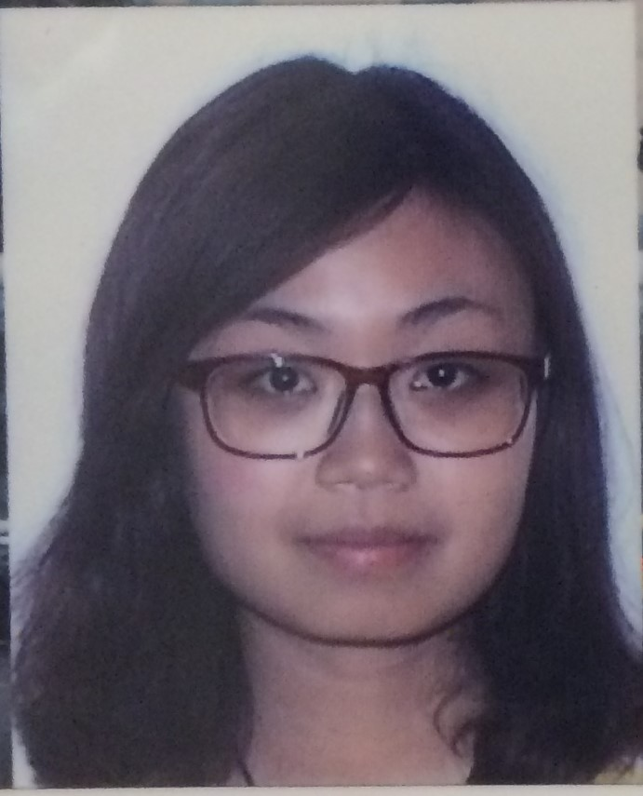
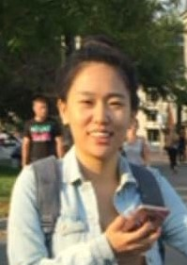

 | Lan Yao | Aoshuang Wang | Yixuan Huang | Lan Luo
Challenge 1 | Presenter
Challenge 2 |  |  | Presenter
Challenge 3 |  | Presenter
Challenge 4 |  |  |  | Presenter
Challenge 5 | Presenter
Challenge 6 |  |  | Presenter
Challenge 7
Challenge 8

Slide 3
 | Lan Yao | Aoshuang Wang | Yixuan Huang | Lan Luo
 | Program Writing Webpage Control | Program Writing Webpage Control | Webpage Design Remote Access | Remote Access IOS App Design & Control

Slide 4
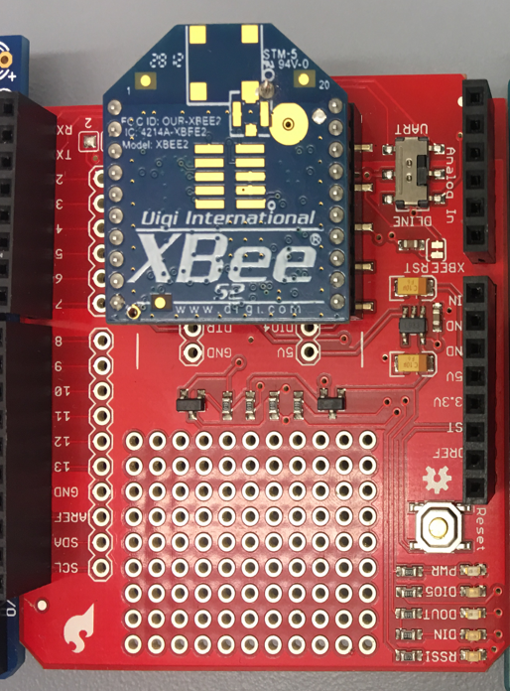
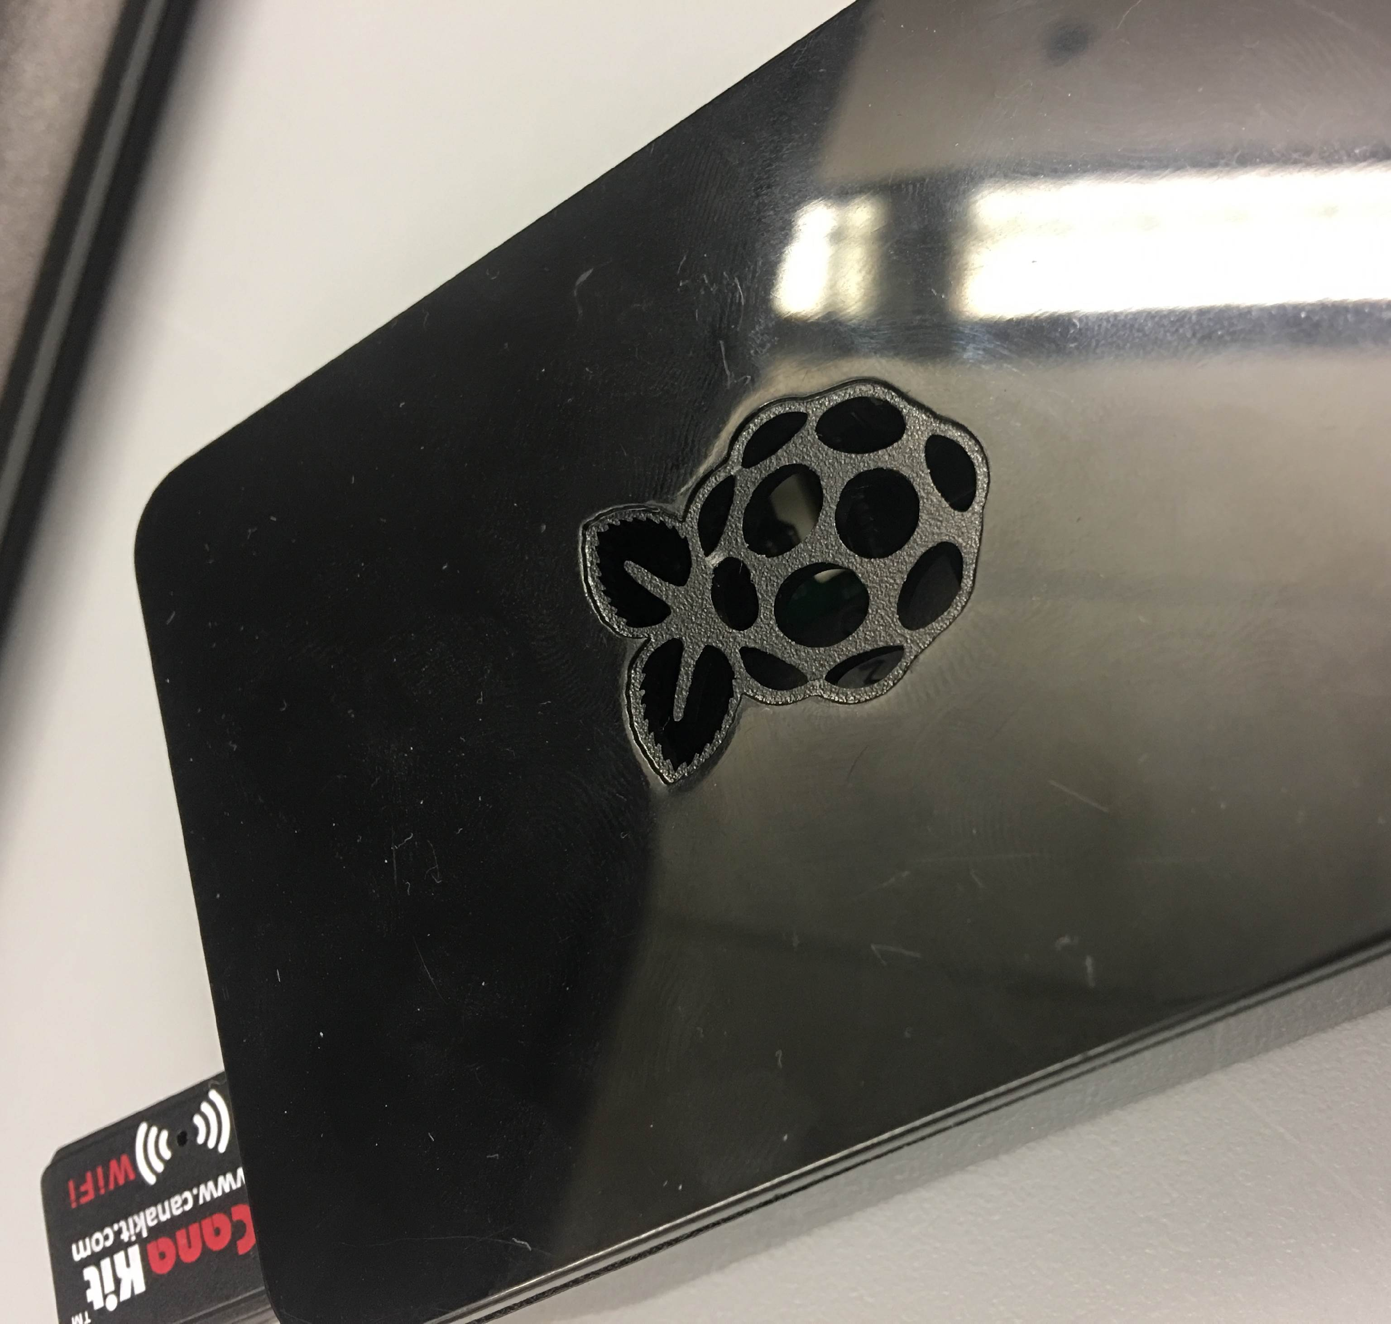
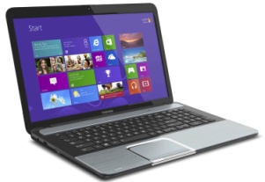
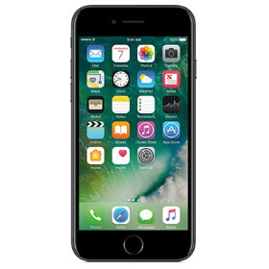
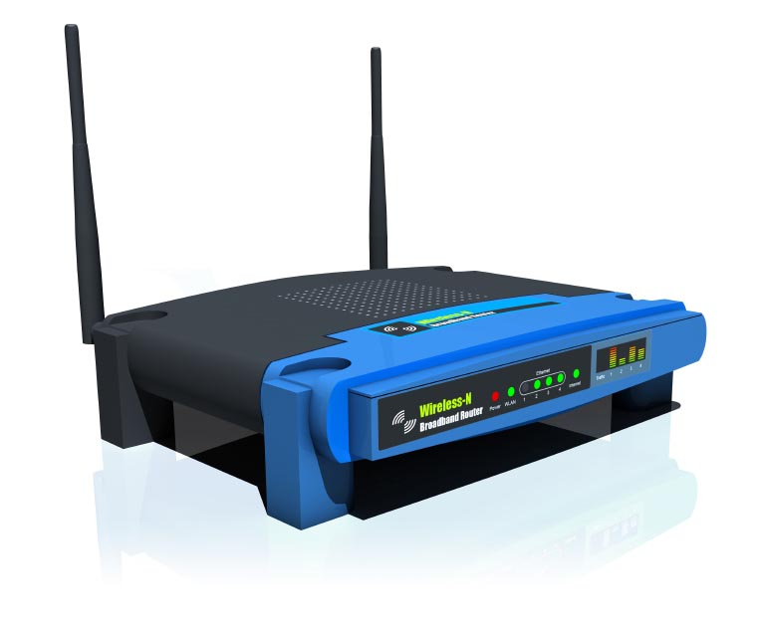
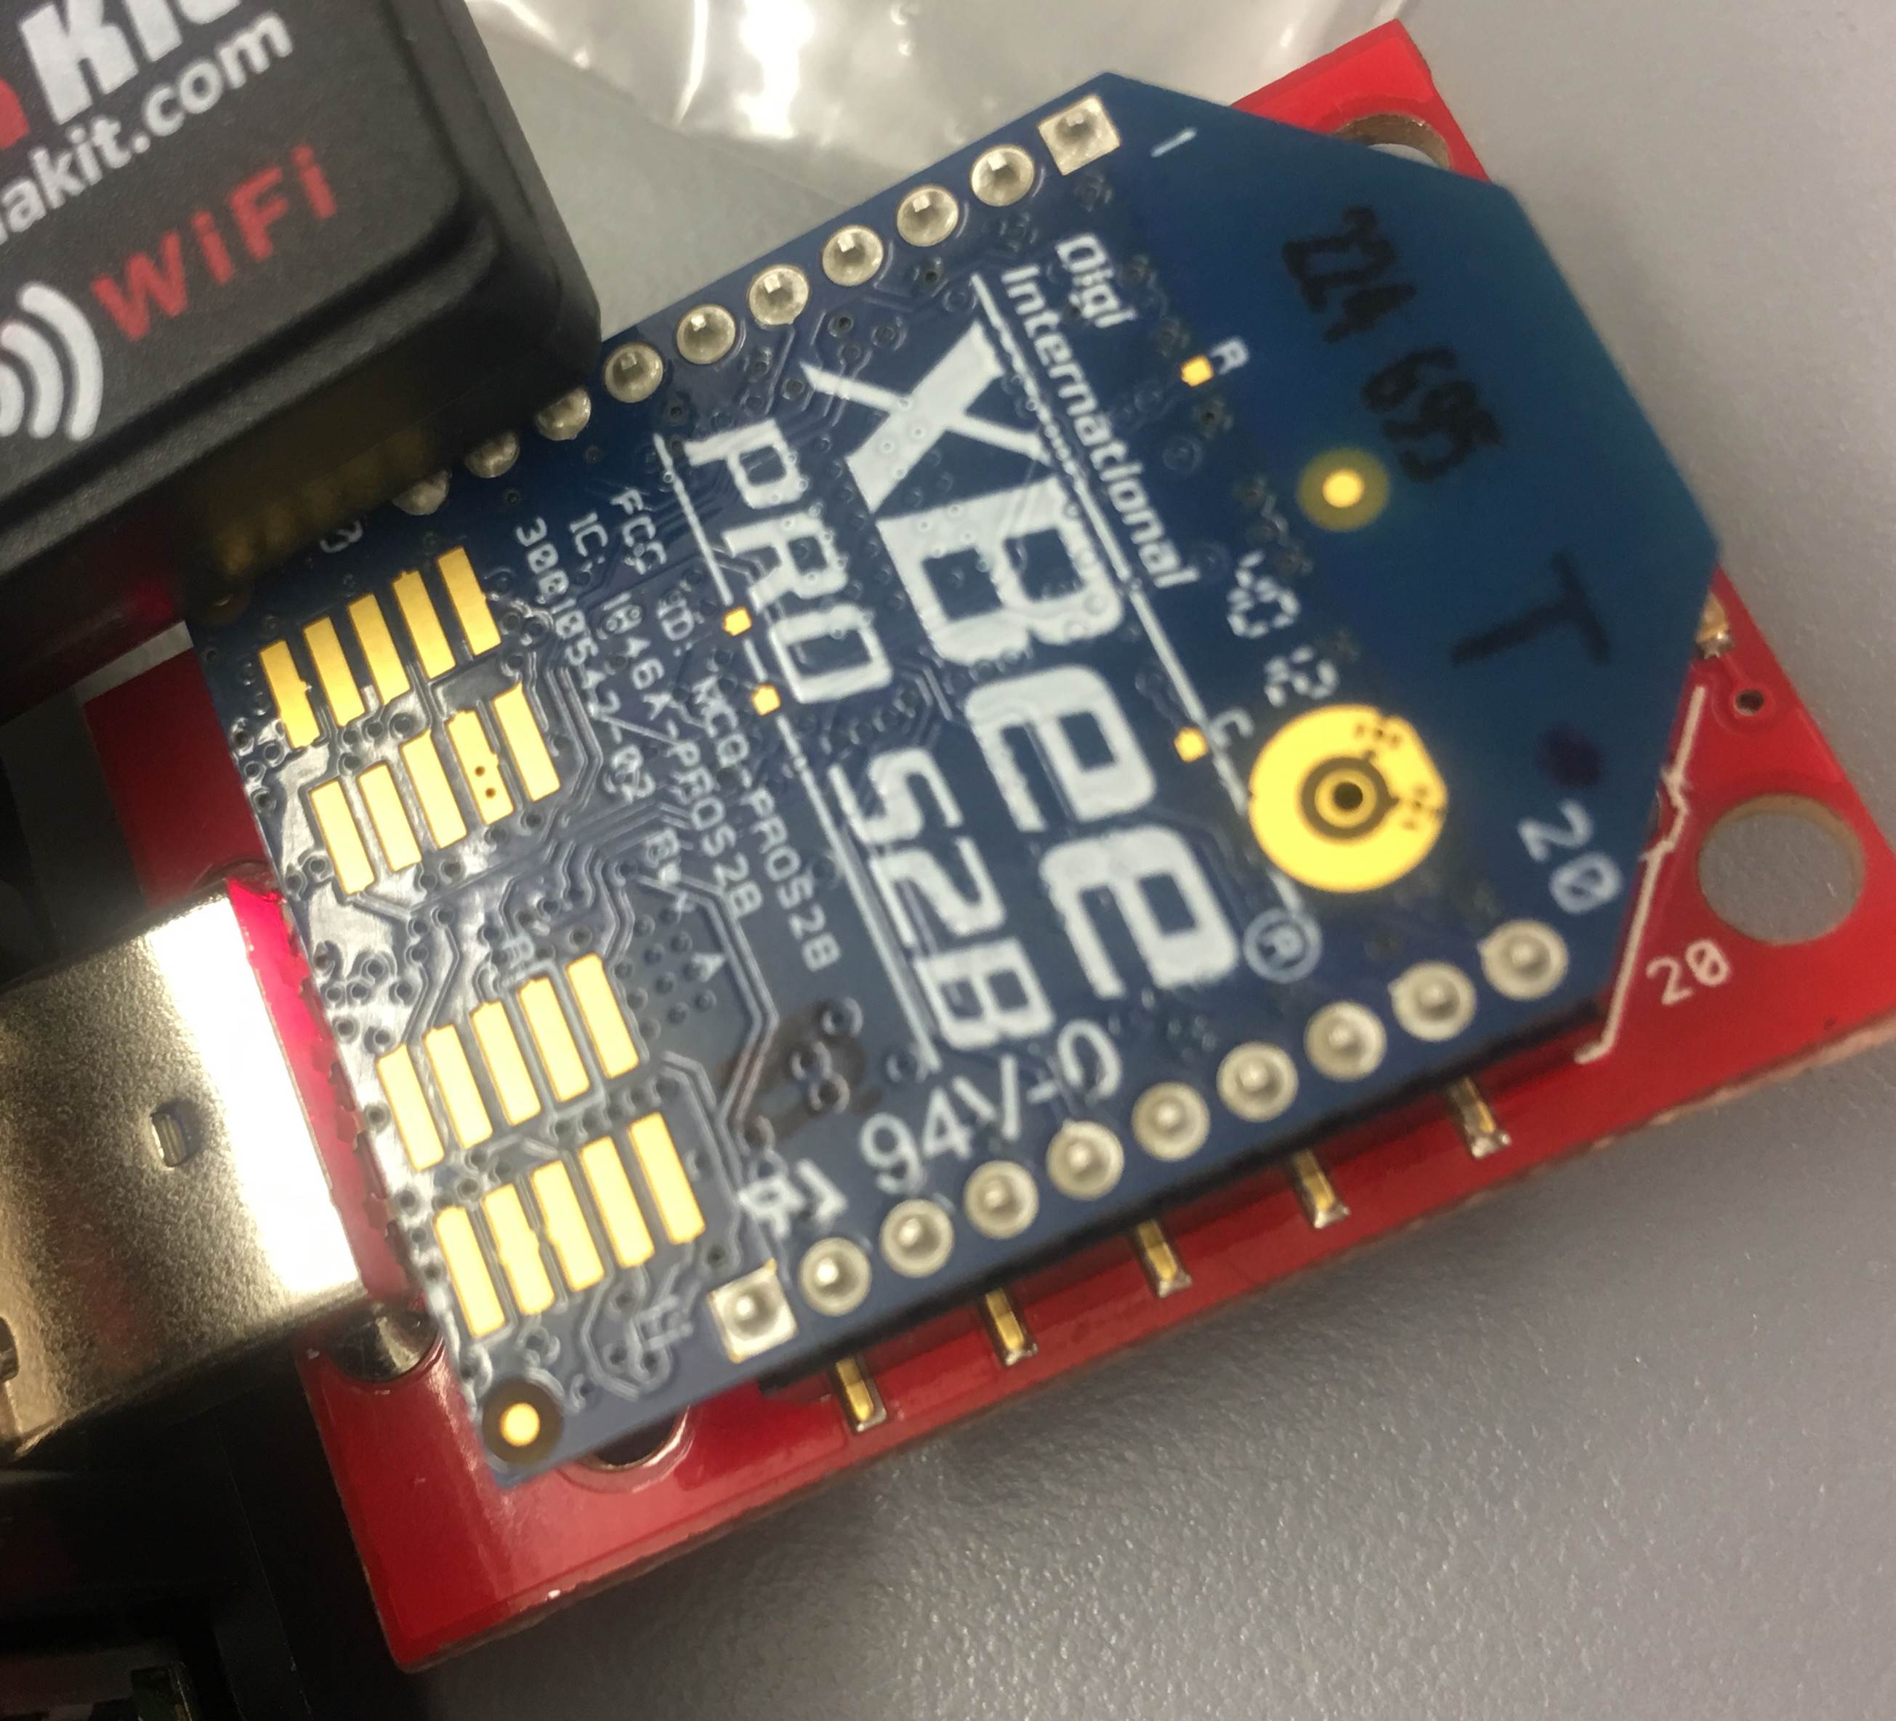
Devices
Laptop
Phone
Raspberry Pi
Router XBee
Router
Coordinator XBee

Slide 5

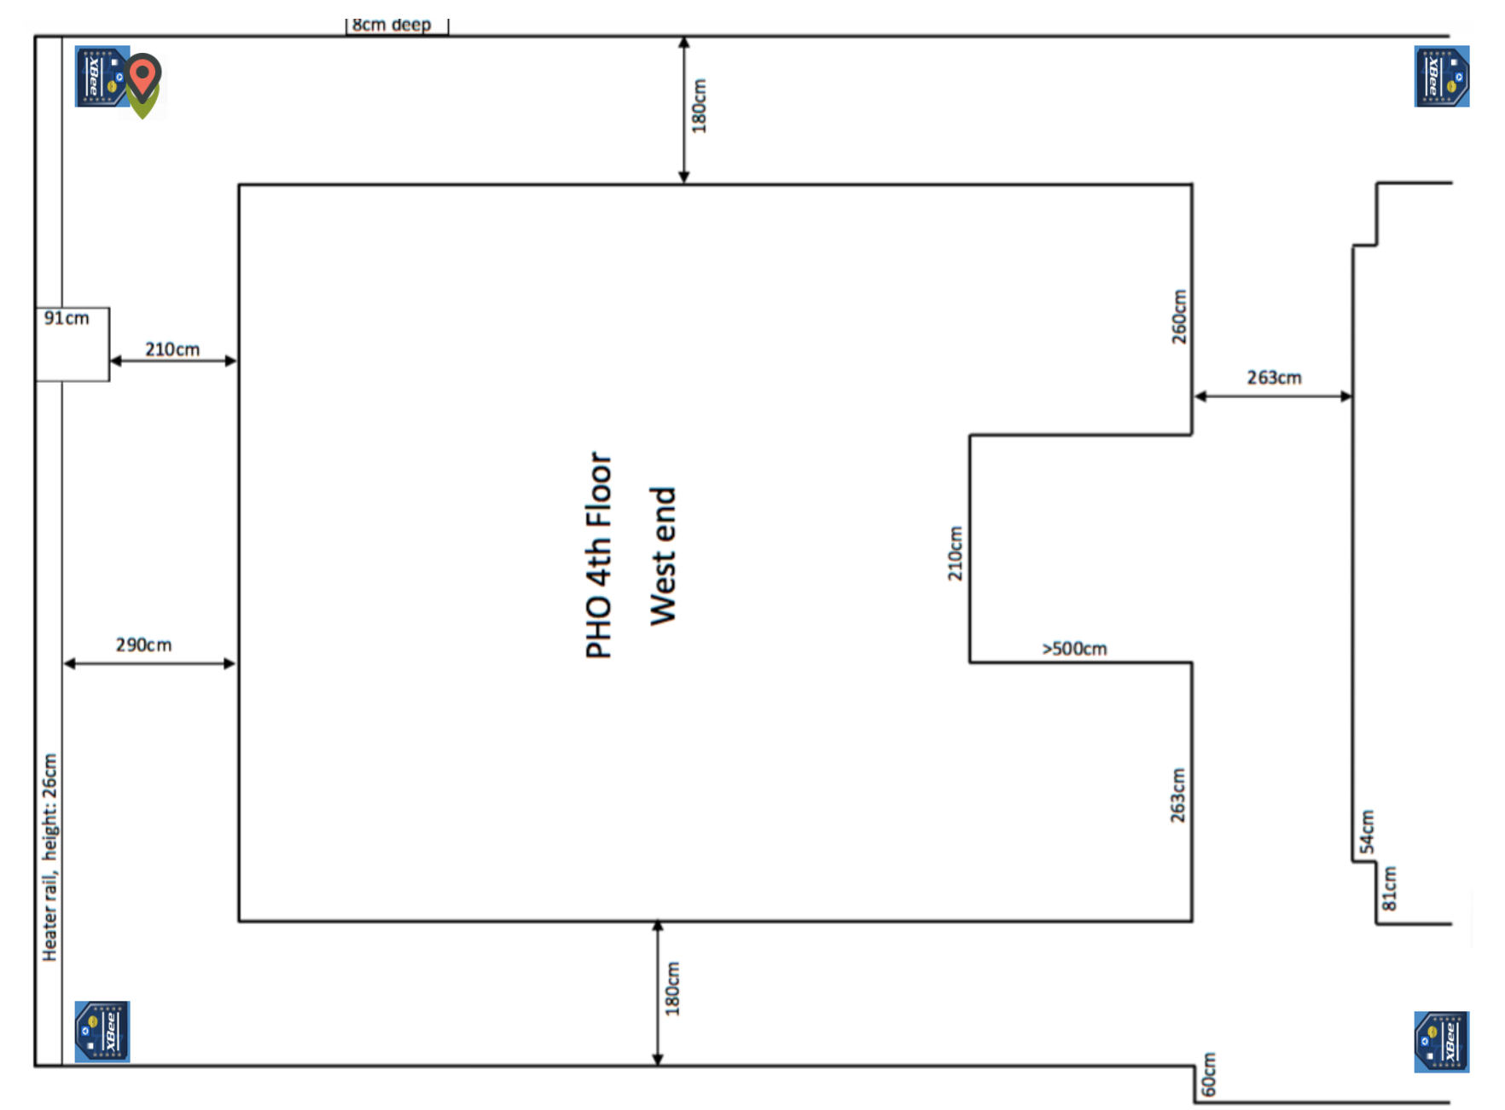

Main Architecture
group3story.hopto.org
Port: 4000
Client: Laptop & Phone
Under Group3 WiFi
Port Forwarding
to Server’s Static
Address: 4000
Bidirectional
Data Exchange
Server: Pi & Laptop

Slide 6
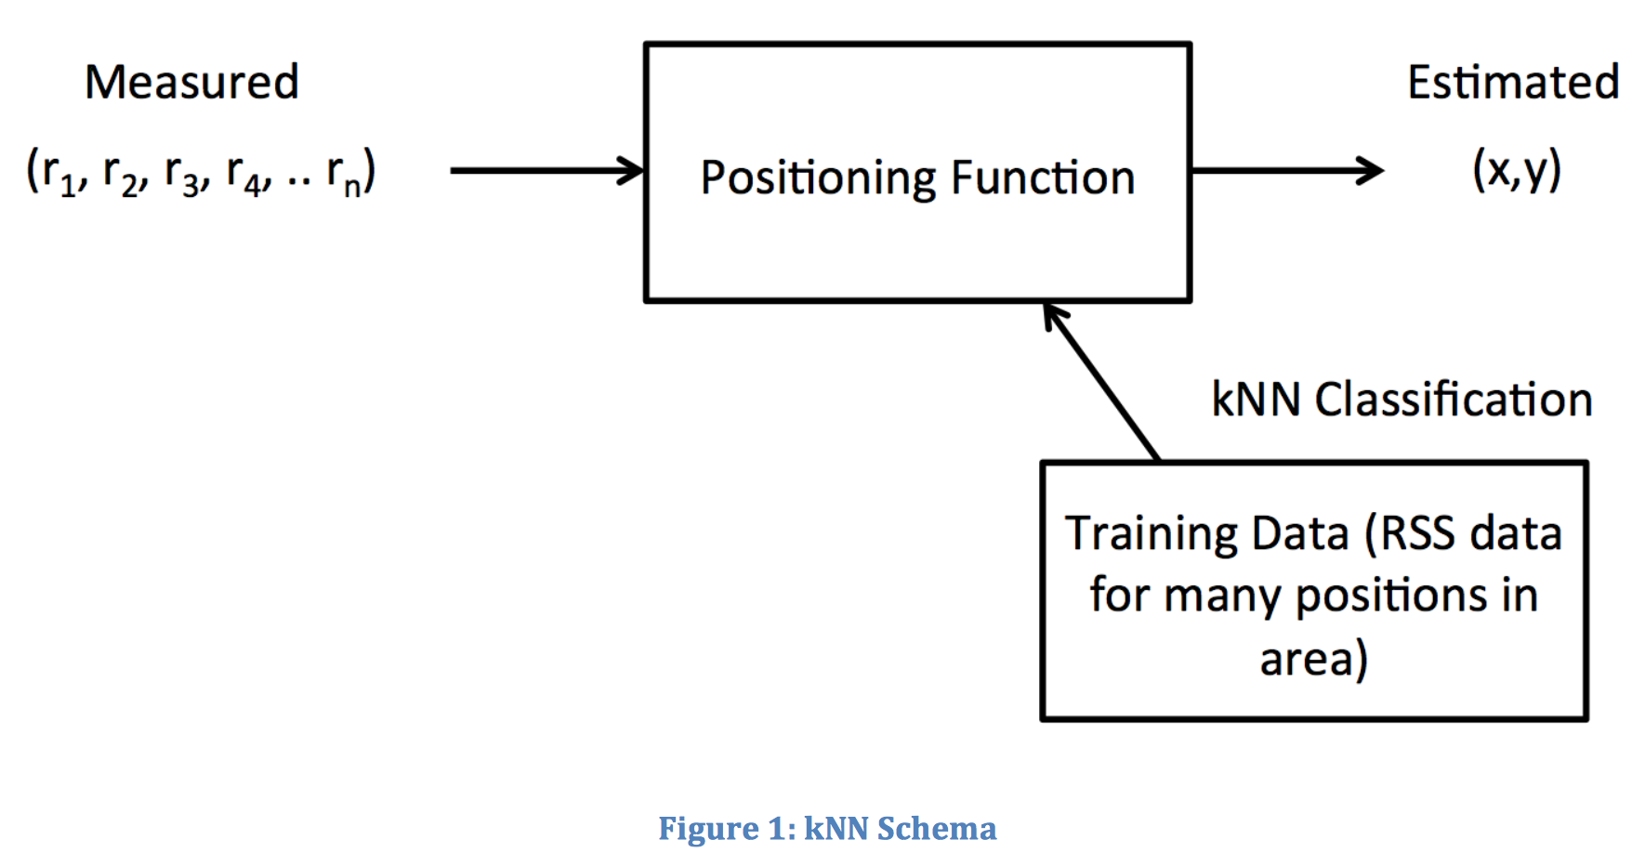
KNN
We divided the 4th floor into 50 classes which match the requirement of finding position of static device to within approximately 1m . And we measured 5 nodes in each class.
Beacon1 | Beacon2 | Beacon3 | Beacon4 | Class
76(dBi) | 102 | 84 | 83 | 5
… | … | … | … | N

Slide 7
Collection:
[41,68,68,74],[40,67,67,75],[40,67,69,75],[40,67,68,74],[39,71,70,78],[49,83,74,84],[48,84,77,80],[46,84,75,86],[43,82,70,81],[51,80,70,81],[...],[...],[...],[...],[...],............]
predictions :
[ 1, 1, 1, 1, 1, 2, 2, 2, 2, 2, 3, 3, 3, 3, 3,…………]

Slide 8
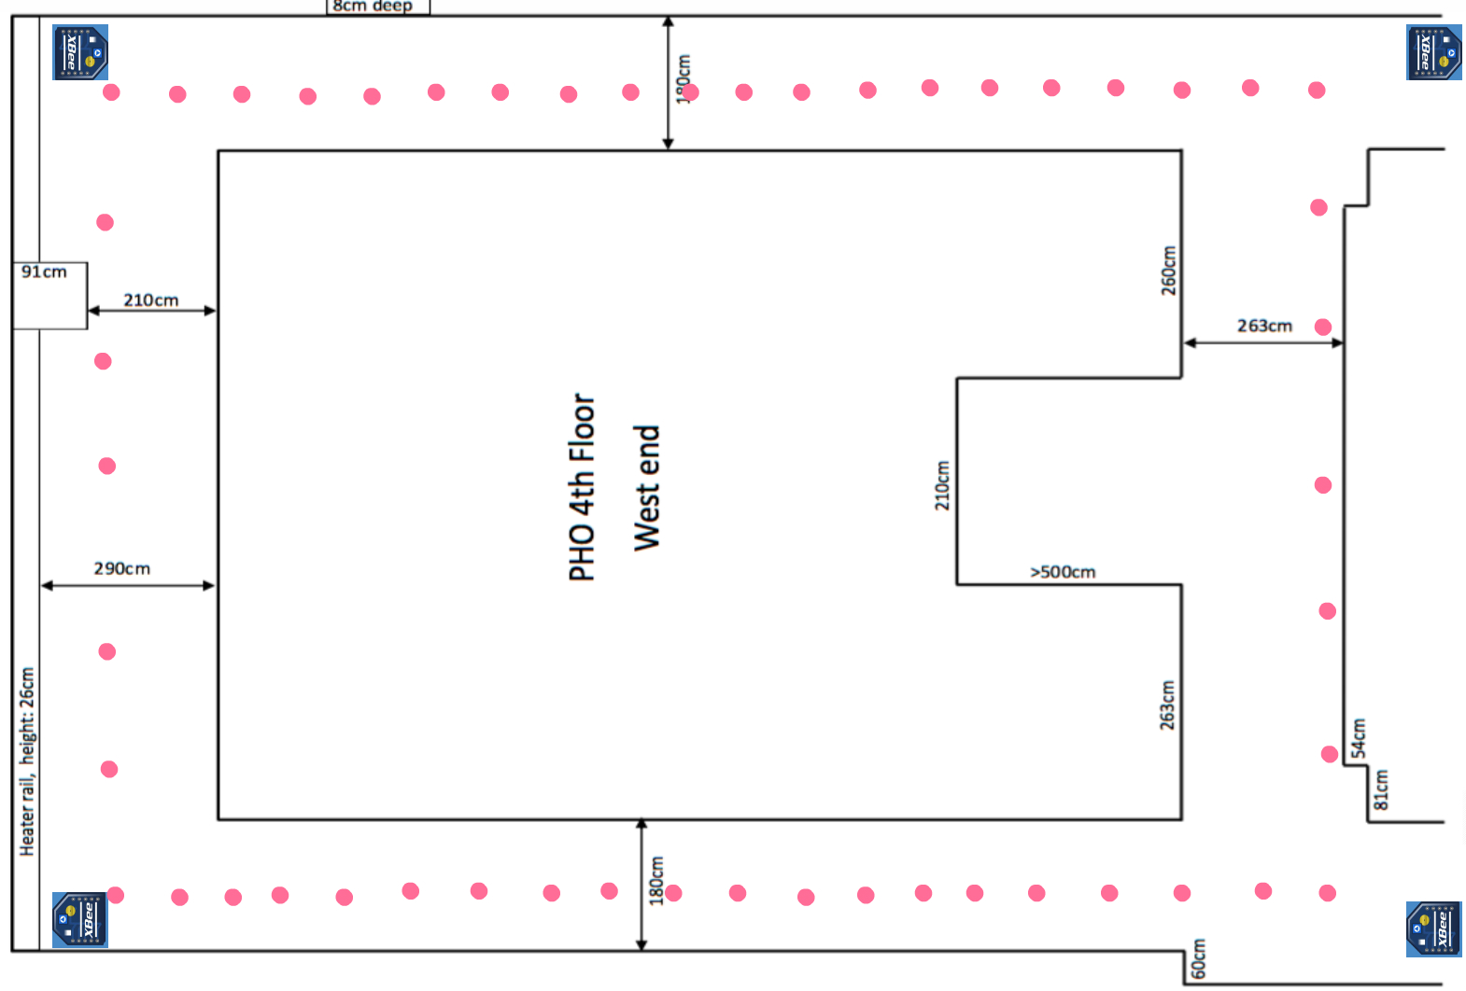
50 classes are categorised by the black tile. And locate them in clockwise direction.
Calculate the distances between points and convert them into coordinates in HTML.

Slide 9
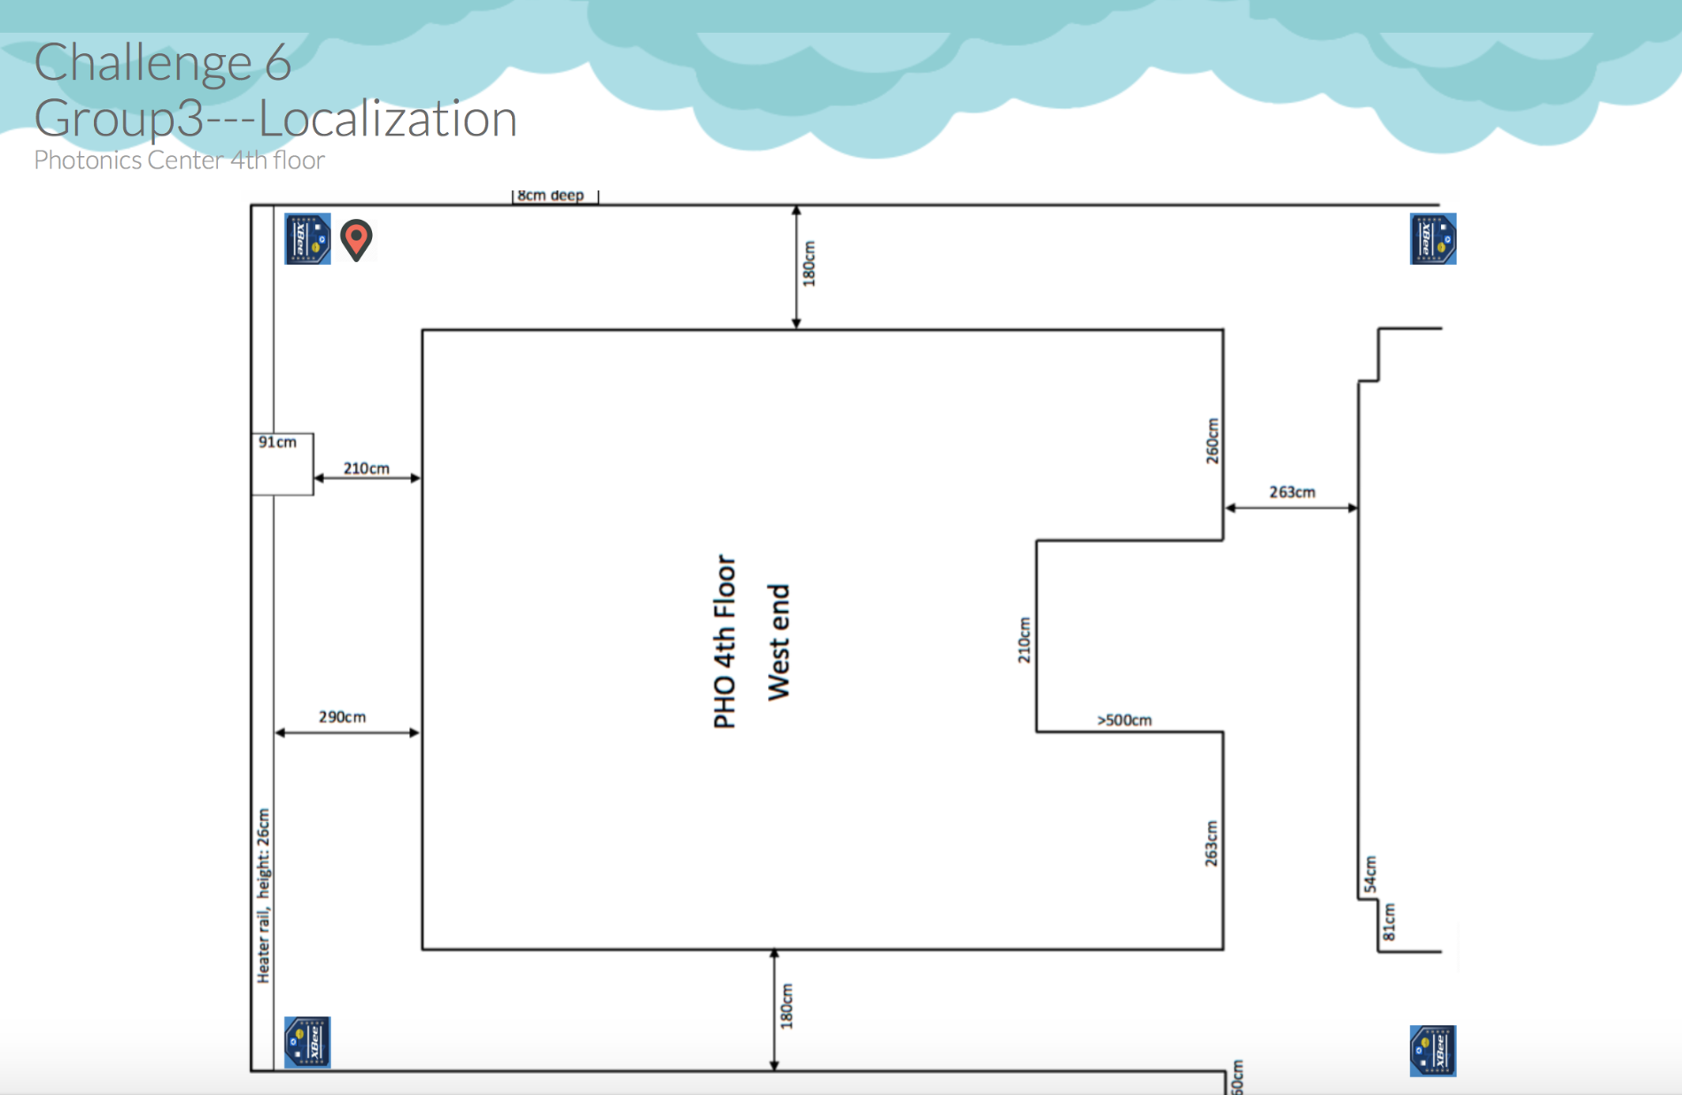
HTML

Slide 10
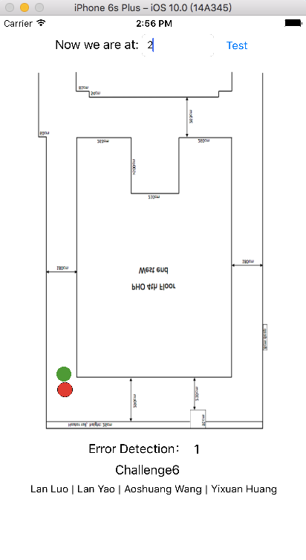
IOS Application

Slide 11
Function:
Movement tracking
Graphic display in 2D
Error Detection
Library:
socket.io-client-swift:
Socket.IO-client for iOS/OS X

Slide 12
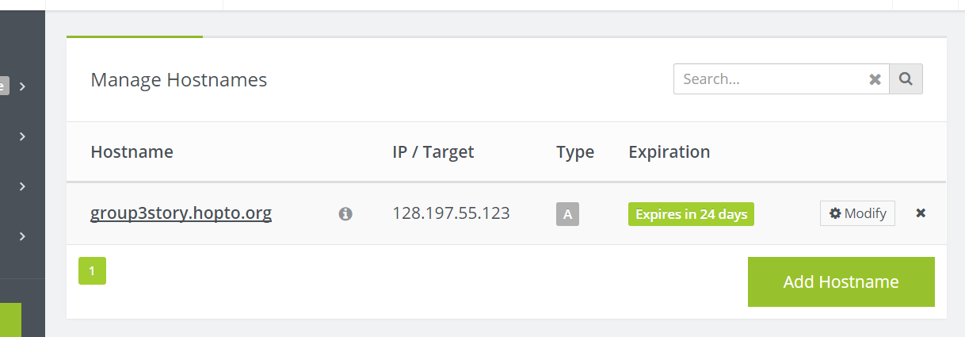
Design Details
Remote access control Method:
DDNS : No-ip

Slide 13
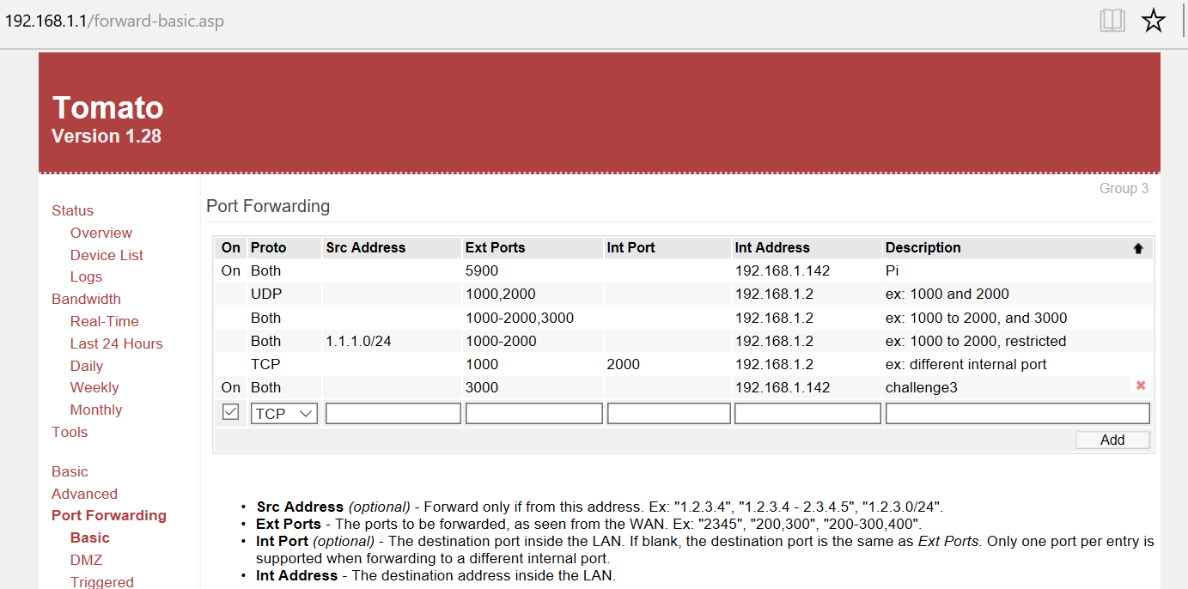
Design Details
Remote access control:
Port Forwarding:

Slide 14
Challenge
Reboot the Raspberry Pi
The accuracy of measurement
Jump issue
Influence from surrounding.(WIFI , power band , laptop, etc.)

